Slide 1
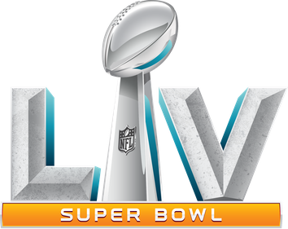
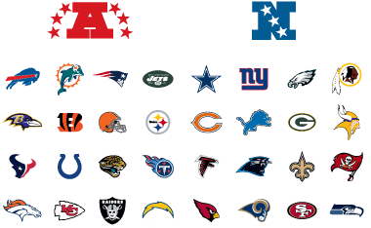
Super Bowl LV Predictions
Picking a Winner
East
North
South
West

Slide 2
What Makes a Winning Team?
Project Overview
Model Results
Insightful Features
Project Description
The purpose of this project is to predict the outcome of the 2020 NFL Super Bowl LV winning team using historical regular season team offense and defense statistics. This is a Binary Classification problem as the result of the Super Bowl has two outcomes, win or lose. The goal is to create a linear regression machine learning model that most accurately predicts the winner.
Data Collection & Assembly
I used several approaches to creating input data and combined the features I found most useful. This data was sourced from http://www.pro-football-reference.com/.
This is a plain batch dataset complied of 10 regular seasons of Offense, Defense and Super Bowl historical statistics. These csv files were stitched and merged as part of the initial data preprocessing. This dataset contains 11,616 observations and 29 features.
The dataset had no odd or missing values resulting in zero data being dropped. Were applicable team names were aligned due to franchise rebranding.
Oakland Raiders > Las Vegas Raiders
San Diego Chargers > Los Angeles Chargers
Washington Redskins > Washington Football Team
St. Louis Rams > Los Angeles Rams
3 primary files: NFL Historical Statistics – Offense; NFL Historical Statistics – Defense; NFL Historical Statistics – Super Bowl Winners
Model & Parameter Tuning
For the model, I used Sklearn to create a Logistic Regression.
To reduce multicollinearity between features, I applied Principal Component Analysis (PCA) (n_component = 3).
To account for data imbalance, I derived a ROC curve to identify the optimal threshold. (Best Threshold = 0.016919; G –Mean = 0.856)
To further tune, I ran a GridSearchCV to get the optimal model parameters.
Performance Measure
Baseline Accuracy: 98%
Model Testing Accuracy: 97% (less than Baseline)
Top Ten Super Bowl LV Predictions using Logistic Regression Model
Prediction | Division | Team | Offense Rank | Defense Rank | Prediction (%)
1 | NFC South | Buccaneers | 3 | 8 | 0.234
2 | AFC North | Steelers | 12 | 3 | 0.072
3 | NFC West | Rams | 22 | 1 | 0.042
4 | NFC South | Saints | 5 | 5 | 0.039
5 | AFC South | Colts | 9 | 10 | 0.036
6 | AFC West | Chiefs | 6 | 11 | 0.026
7 | AFC East | Bills | 2 | 16 | 0.020
8 | NFC West | Seahawks | 8 | 15 | 0.018
9 | NFC North | Packers | 1 | 13 | 0.016
10 | AFC North | Ravens | 7 | 2 | 0.011
Key Takeaways
Results & Observations
With a 23% accuracy, the model correctly predicted the Tampa Bay Buccaneers to win Super Bowl LV!
The majority of the ranked teams have a top ten offense. (8 out of 10)
Of the two ranked teams without a top ten offense, both have a top five defense (Steelers: #3; Rams: #1)
The model predicted one or more teams in 7 of the 8 NFL Divisions in the top ten.
NFC East was the only NFL Division with teams not ranked in the top ten (No surprise as this is a historically bad set of teams)
The Divisions with 2 teams ranked in the top ten are historically competitive teams. (Ex: AFC North –Steelers and Ravens typically compete for Division Titles)
Further Model Development
Machine learning for sports predictions is not a basic classification problem.
Further project scope includes:
Team head-to-head, individual player statistics
Weather, Home/Away Analysis
Classification Neural Network
Recommendation
Sports Gambling Disclaimer: Although the model results in this report should be viewed as reliable, I do not guarantee their accuracy. This model is not meant to be used, NOR SHOULD BE USED, as the basis of any sports gambling.
SB Winners were above the League average in penalties (5 of 11 yrs.)
Low correlation between number of Offense penalties and the SB Winner
Key Takeaways
SB Winners were above the League average of penalties (6 of 11 yrs.)
Low correlation between number of Defense penalties and the SB Winner

